Slide 1

Tutorial AWS DeepRacer
By Jeet Swadia
Guided By Prof. Jian Li

Slide 2
Outline For the Tutorial
Theoretical Explaination
How to Start?
Training and Evaluation
Designing Own Vehicle
Community Race

Slide 3
AWS DeepRacer
An integrated learning system to experience and experiment Reinforcement Learning
It has three main components:
AWS DeepRacer Console
AWS DeepRacer Vehicle
AWS DeepRacer League
It is one of the 28 services provided by AWS under the tree of Machine Learning
This service takes help from AWS SageMaker and AWS RoboMaker

Slide 4

AWS DeepRacer Console
A Graphical User Interface (GUI) to interact with AWS DeepRacer services
This console is used to train an RL model with specified reward function, optimization algorithm, environment, and hyperparameters*
Once trained, the model shall get tested on the track made by AWS ML services named SageMaker and RoboMaker in order to evaluate performance
This console is required to deploy the trained model into AWS DeepRacer Vehicle
There are two parts for DeepRacer:
Virtual Model + Testing
Physical Model (Vehicle)

Slide 5
AWS DeepRacer Vehicle
It is a 1/18th scale car/robot
The first version build has one camera as input and is Wi-Fi enabled
This vehicle has both manual and autonomous modes
Autonomous mode runs inference on compute module of the vehicle which uses camera input
Wi-Fi connection enables the vehicle to connect with a computer or a mobile device to control the physical vehicle console and it also allows to update the software in the vehicle
The second version build has two cameras and a radar system to make vehicle more robust in different application

Slide 6
AWS DeepRacer League
A competition to gauge your stand globally
AWS DeepRacer League has transformed online as of 2020 after successfully hosting physical race at their yearly event AWS re:Invent
It has three different types of scenarios for training:
Time Trial
Object Avoidance
Head-to-Head Racing

Slide 7
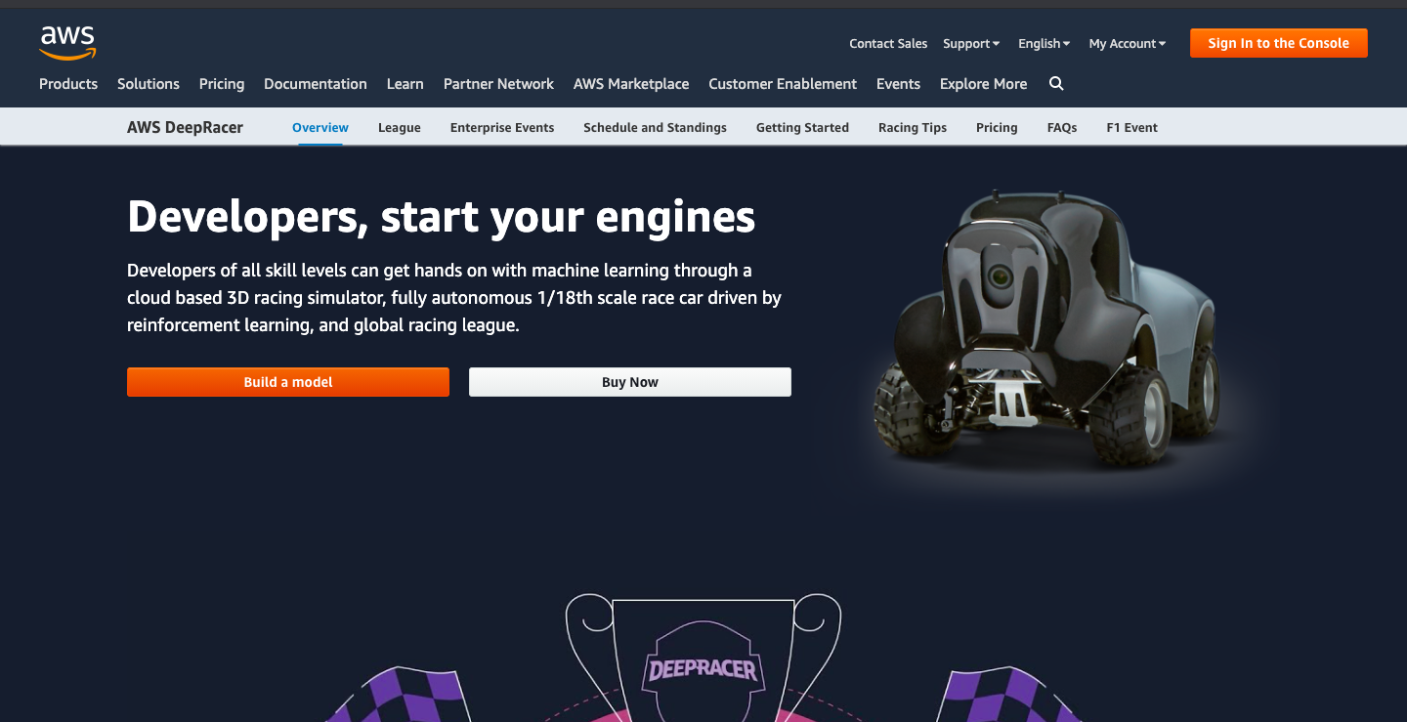
Steps to Follow
DeepRacer Homepage

Slide 8
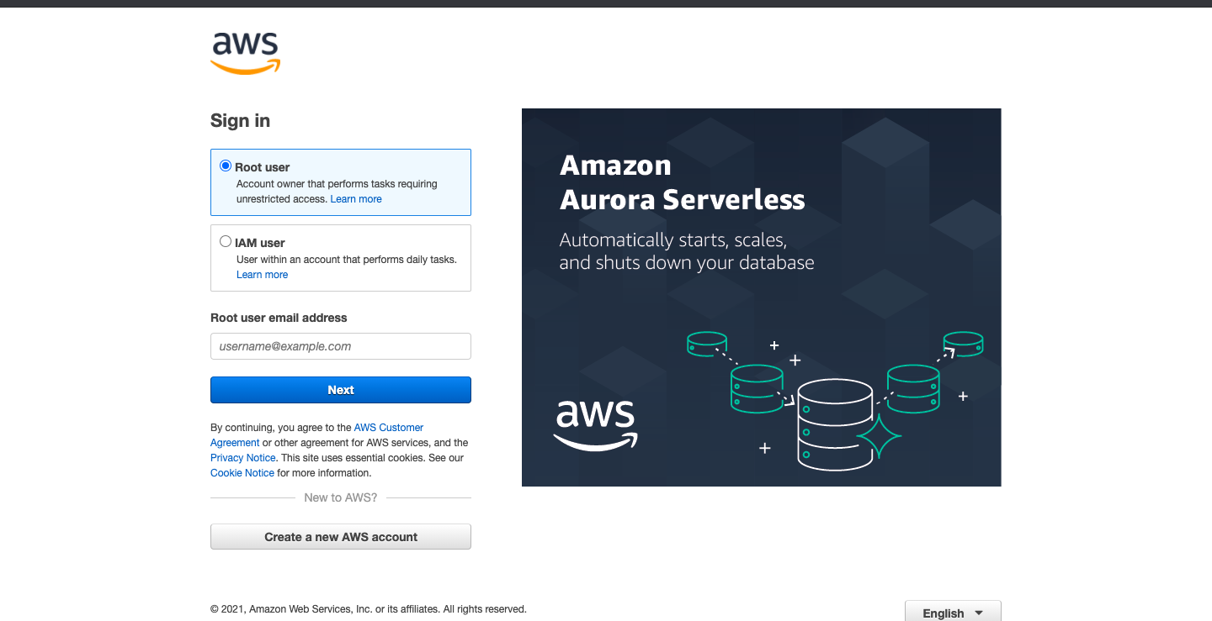
Steps to Follow
Sing Up/Sign in as Root User

Slide 9
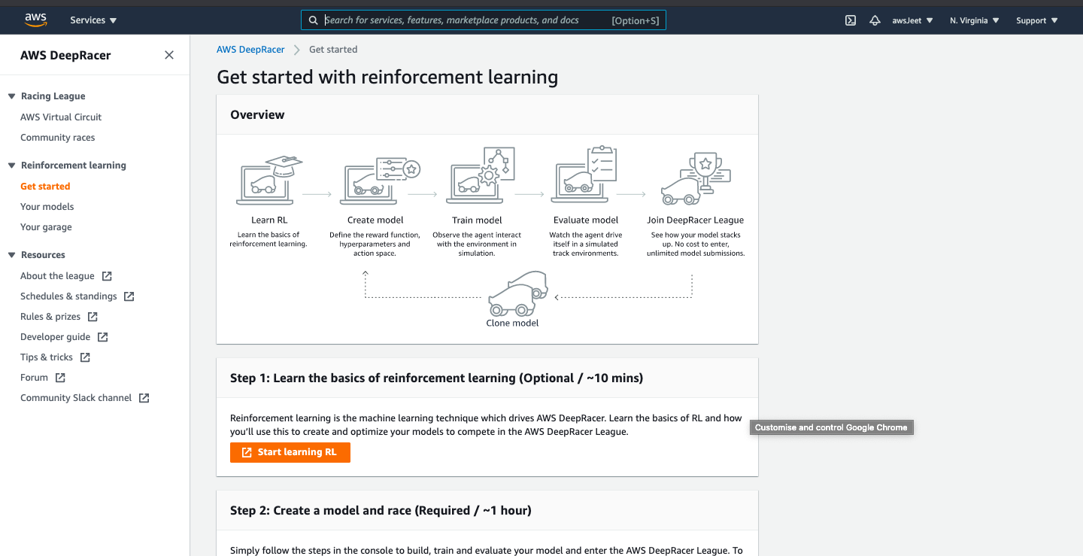
Steps to Follow
You will be on Console page once logged in succesfully

Slide 10
References
AWS DeepRacer Guide
AWS YouTube Channel

Slide 11

Thank you! jswadia1@binghamton.edu

